Slide 1
Graphs Data Structure

Slide 2
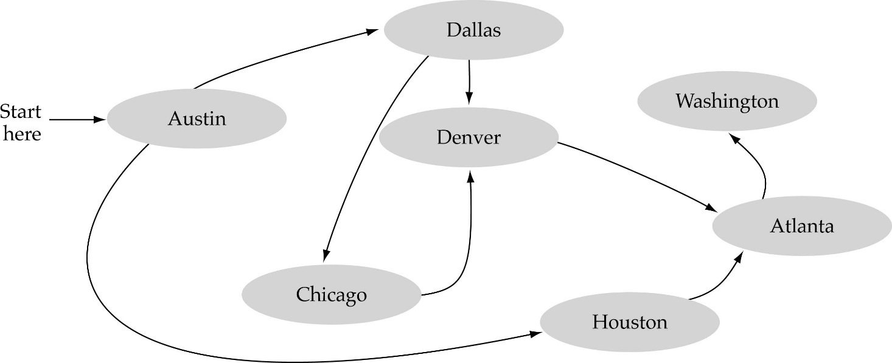
What is a graph?
A data structure that consists of a set of nodes (vertices) and a set of edges that relate the nodes to each other
The set of edges describes relationships among the vertices

Slide 3
Formal definition of graphs
A graph G is defined as follows:
G=(V,E)
V(G): a finite, nonempty set of vertices
E(G): a set of edges (pairs of vertices)

Slide 4
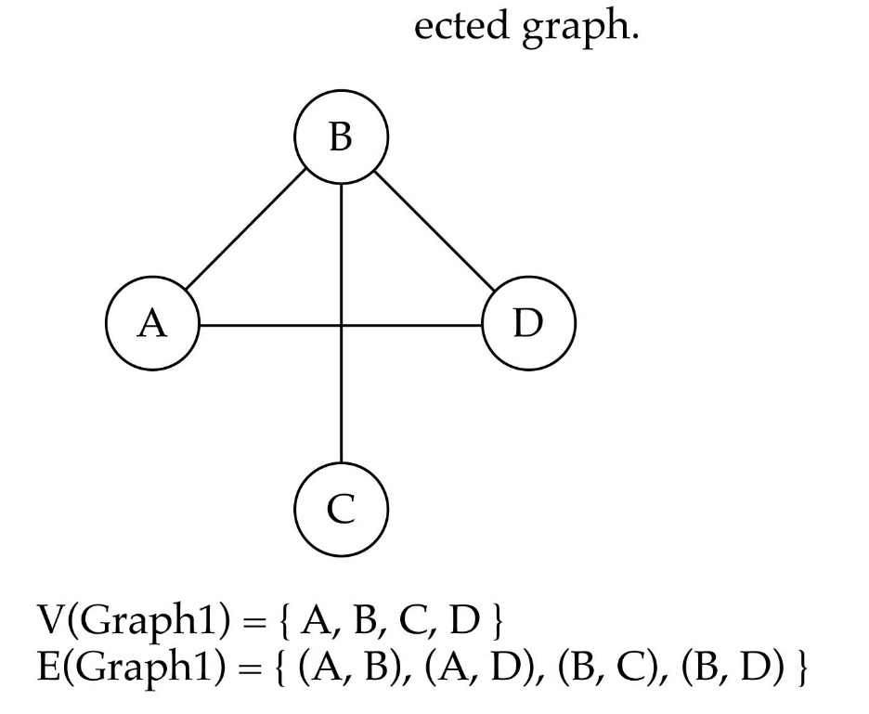
Directed vs. undirected graphs
When the edges in a graph have no direction, the graph is called undirected

Slide 5

Directed vs. undirected graphs (cont.)
When the edges in a graph have a direction, the graph is called directed (or digraph)
Warning: if the graph is directed, the order of the vertices in each edge is important !!
E(Graph2) = {(1,3) (3,1) (5,9) (9,11) (5,7)

Slide 6

Trees vs graphs
Trees are special cases of graphs!!

Slide 7
DiGraph terminology
A directed graph (G) is therefore a pair (V,E) where E is a binary relation on V
  The set V is called Vertex set of G (Vertices)
  the set E is called Edge set of G (edges)
Vertices are represented by circles and edges by arrows.
Self-loops are edges from a vertex to itself

Slide 8

DiGraph terminology
Adjacent nodes: two nodes are adjacent if they are connected by an edge
Path: a sequence of vertices that connect two nodes in a graph
Length of a path is the number of edges in the path
Out-degree of a vertex is the number of edges leaving it and in-degree is the number entering it
Degree of a vertex =out-degree + in-degree
Complete graph: a graph in which every vertex is directly connected to every other vertex
Other terms: reachable, subpath, simple, cycle
5 is adjacent to 7
7 is adjacent from 5

Slide 9
Undirected Graph terminology
An Undirected graph (G)= (V,E),
  E consists of unordered pairs therefore we write (u,v) instead of {u,v} and (u,v) is considered same as (v,u)
Self-loops are forbidden
Adjacent relation is symmetric
Given an edge (u,v) then (u,v) is incident on vertices u and v
Degree of a vertex is the number of edges incident on it
A vertex with degree 0 is said to be isolated
Connected graph – every pair of vertices is connected by a path
A connected, acyclic graph is called a (free) tree; it is a forest if not connected
A complete graph – every pair of vertices is adjacent

Slide 10
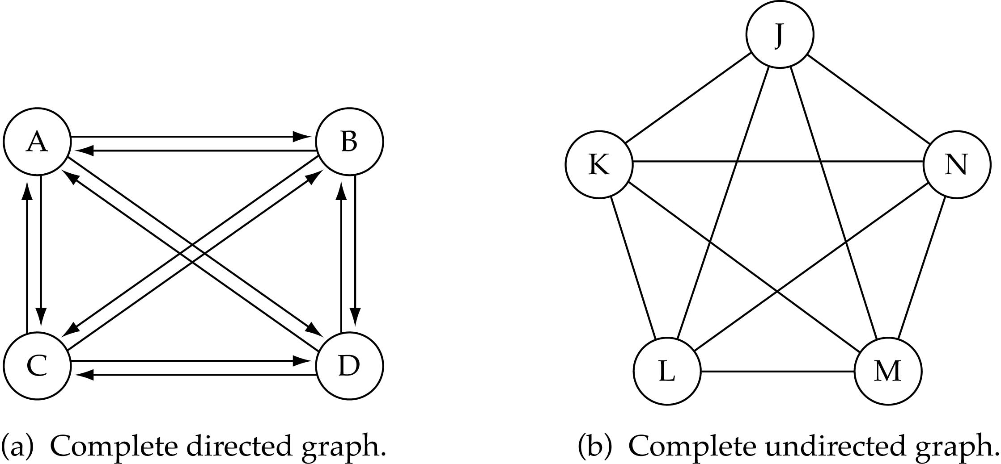
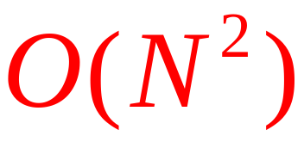
Graph terminology (cont.)
What is the number of edges in a complete directed graph with N vertices?
N * (N-1)

Slide 11
Graph terminology (cont.)
What is the number of edges in a complete undirected graph with N vertices?
N * (N-1) / 2

Slide 12
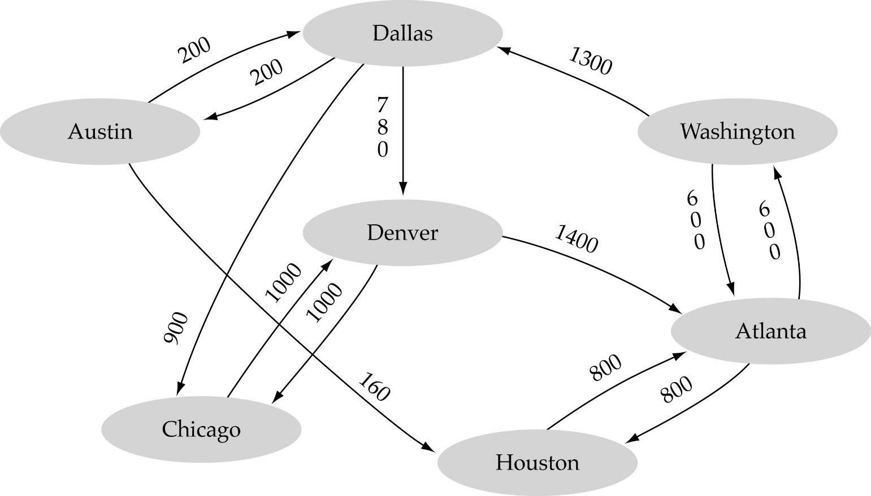
Graph terminology (cont.)
Weighted graph: a graph in which each edge carries a value

Slide 13

Graph implementation
Array-based implementation
  A 1D array is used to represent the vertices
  A 2D array (adjacency matrix) is used to represent the edges

Slide 14
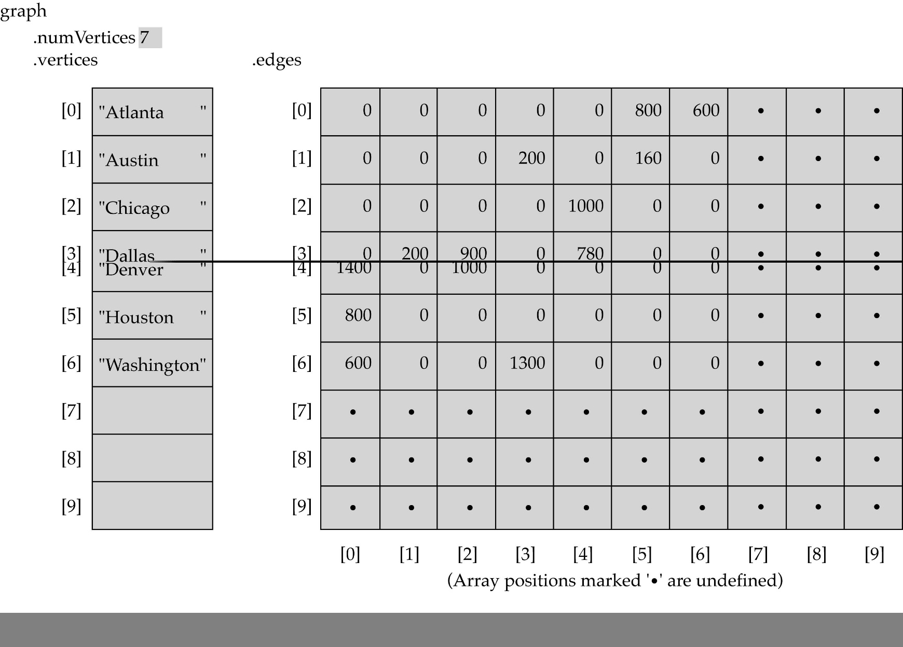
Array-based implementation

Slide 15

Graph implementation (cont.)
Linked-list implementation
  A 1D array is used to represent the vertices
  A list is used for each vertex v which contains the vertices which are adjacent to v (adjacency list)

Slide 16
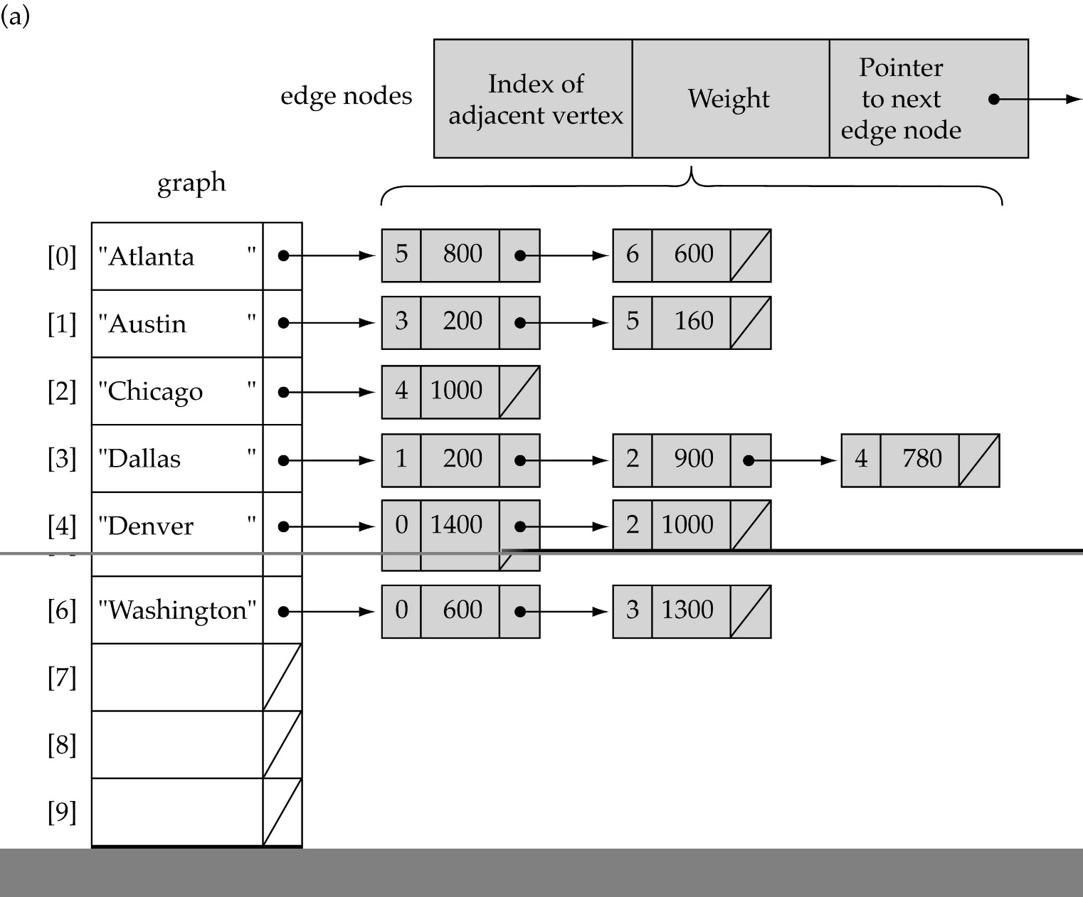
Linked-list implementation

Slide 17
Adjacency matrix vs. adjacency list representation
Adjacency matrix
  Good for dense graphs
  Connectivity between two vertices can be tested quickly
Adjacency list
  Good for sparse graphs
  Vertices adjacent to another vertex can be found quickly
Q. Which of the two do you think requires more memory?

Slide 18
Graph searching
Problem: find a path between two nodes of the graph (e.g., Austin and Washington)
Methods: Depth-First-Search (DFS) or Breadth-First-Search (BFS)

Slide 19
Depth-First-Search (DFS)
What is the idea behind DFS?
  Travel as far as you can down a path
  Back up as little as possible when you reach a "dead end" (i.e., next vertex has been "marked" or there is no next vertex)
DFS can be implemented efficiently using a stack

Slide 20
Breadth-First-Searching (BFS)
What is the idea behind BFS?
  Look at all possible paths at the same depth before you go at a deeper level
  Back up as far as possible when you reach a "dead end" (i.e., next vertex has been "marked" or there is no next vertex)
We will be looking at BFS and DFS later in the course

Slide 21
Single-source shortest-path problem
There are multiple paths from a source vertex to a destination vertex
Shortest path: the path whose total weight (i.e., sum of edge weights) is minimum
Examples:
  Austin->Houston->Atlanta->Washington: 1560 miles
  Austin->Dallas->Denver->Atlanta->Washington: 2980 miles

Slide 22
Single-source shortest-path problem (cont.)
Common algorithms: Dijkstra's algorithm and Bellman-Ford algorithm
BFS can be used to solve the shortest graph problem when the graph is weightless or all the weights are the same

Slide 23
Rooted Trees
A free tree in which one of the vertices is distinguished from others; the root
Terms like ancestor, descendant, parent, child, siblings leaf (external node) and internal node are used

